Slide 1



Chowgacha - Jhenaidah Model: A Social Movement of Health Service Development.
Dr. Md.Emdadul Haque
Senior National Consultant C -J model replication committee

Slide 2
Background History of Community Engagement C-J model
In 1986, UHC is extended to nearby public library and opened 6 bedded indoor and started EPI, with the help of Upazilla Parishad.
In 1994, health complex shifted to new 31 bedded hospital, with 6 bedded labour ward.
UHFPO opened 4 special activities headed by medical officers in Feb. 1996
From January 1997 to 2000 JICA assistance in Frontline MCH Program
< Special activities>
ANC-Corner
Basic EOC service
Under 5 corner for under 5 children
Monthly birth and death record

Slide 3


CHOWGACHA UPAZILA HEALTH COMPLEX
Chowgacha, Jessore.
Previous UHC in 1986

Slide 4




Community Mobilization Meeting at Lohagara in 1995

Slide 5
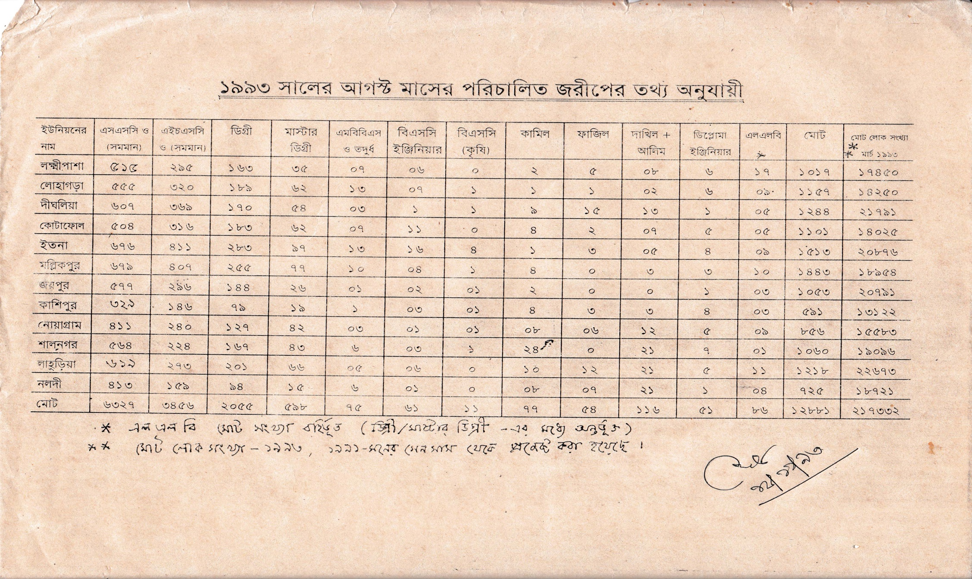
নড়াইলের লোহাগড়া উপজেলায় ইউনিয়নওয়ারী জরীপে জনসম্পদের তথ্য

Slide 6
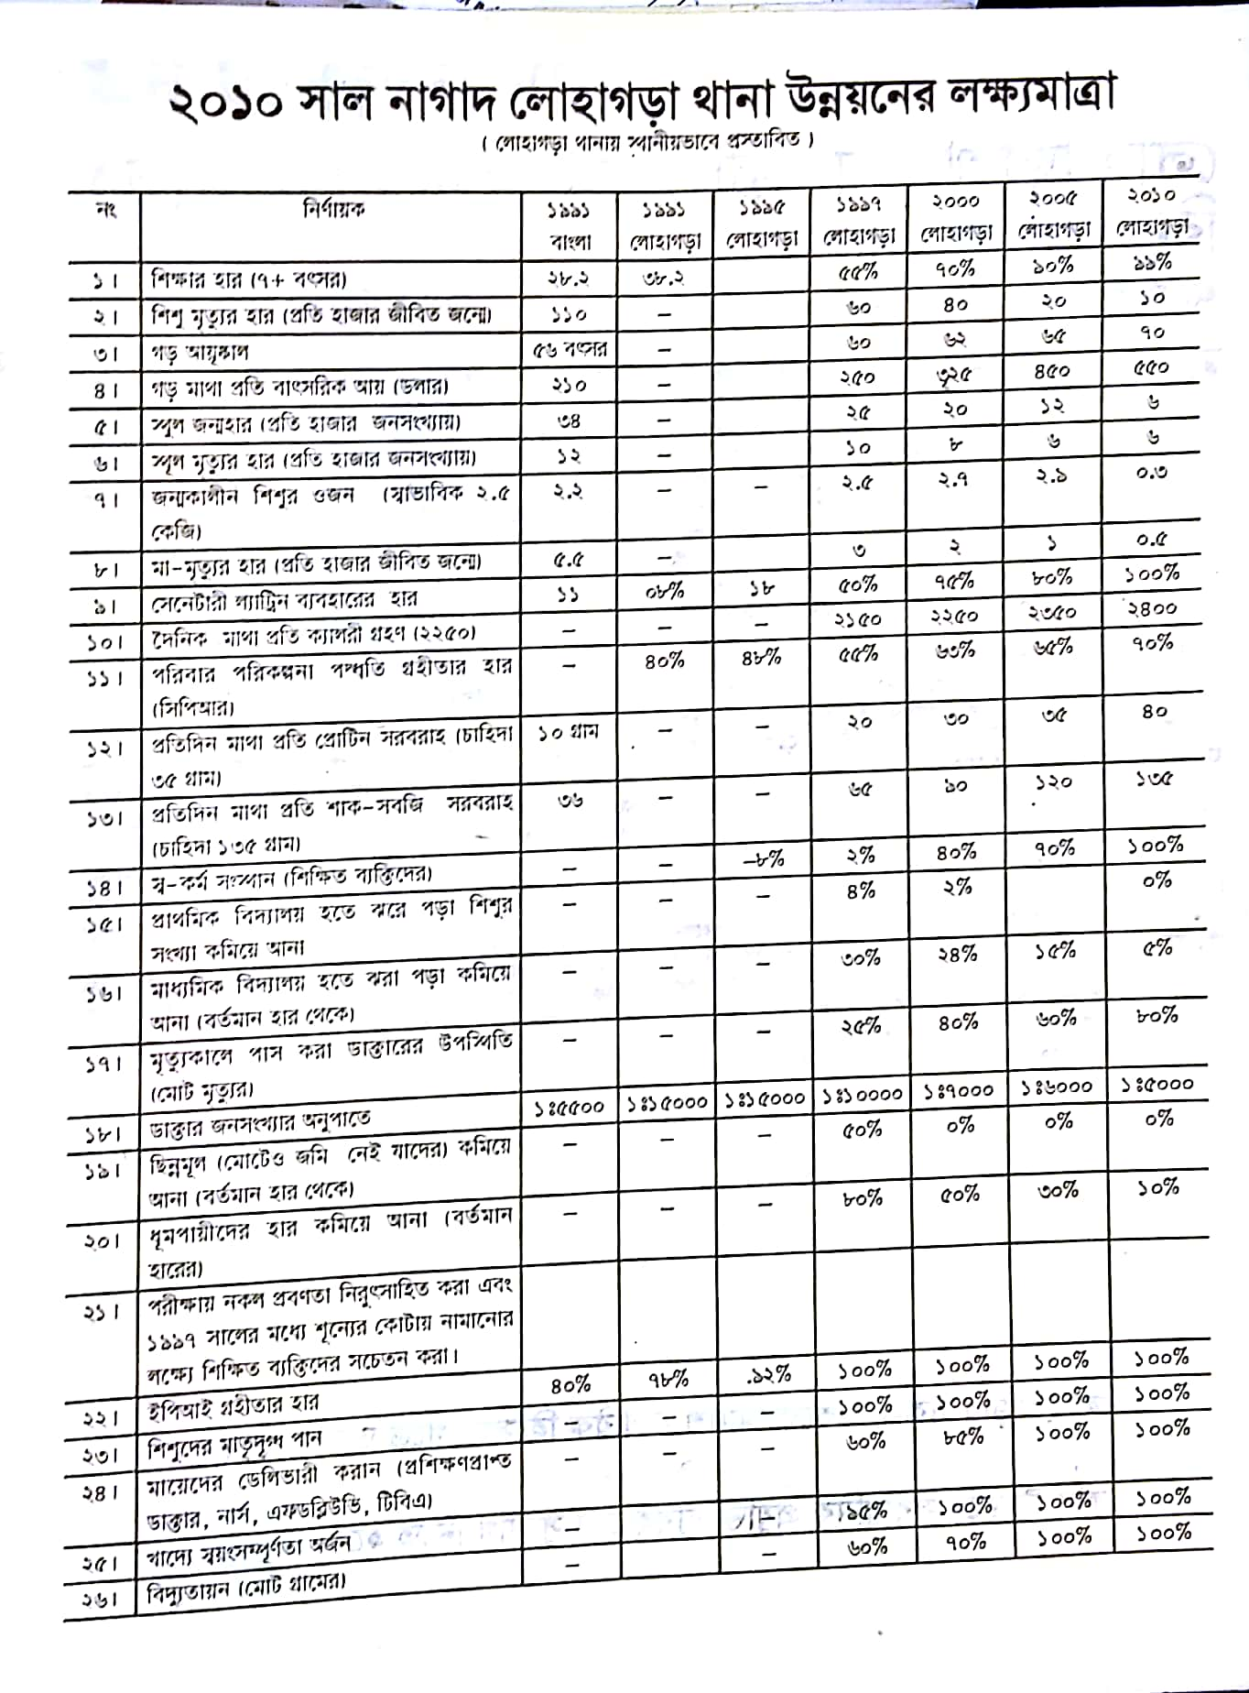

Slide 7
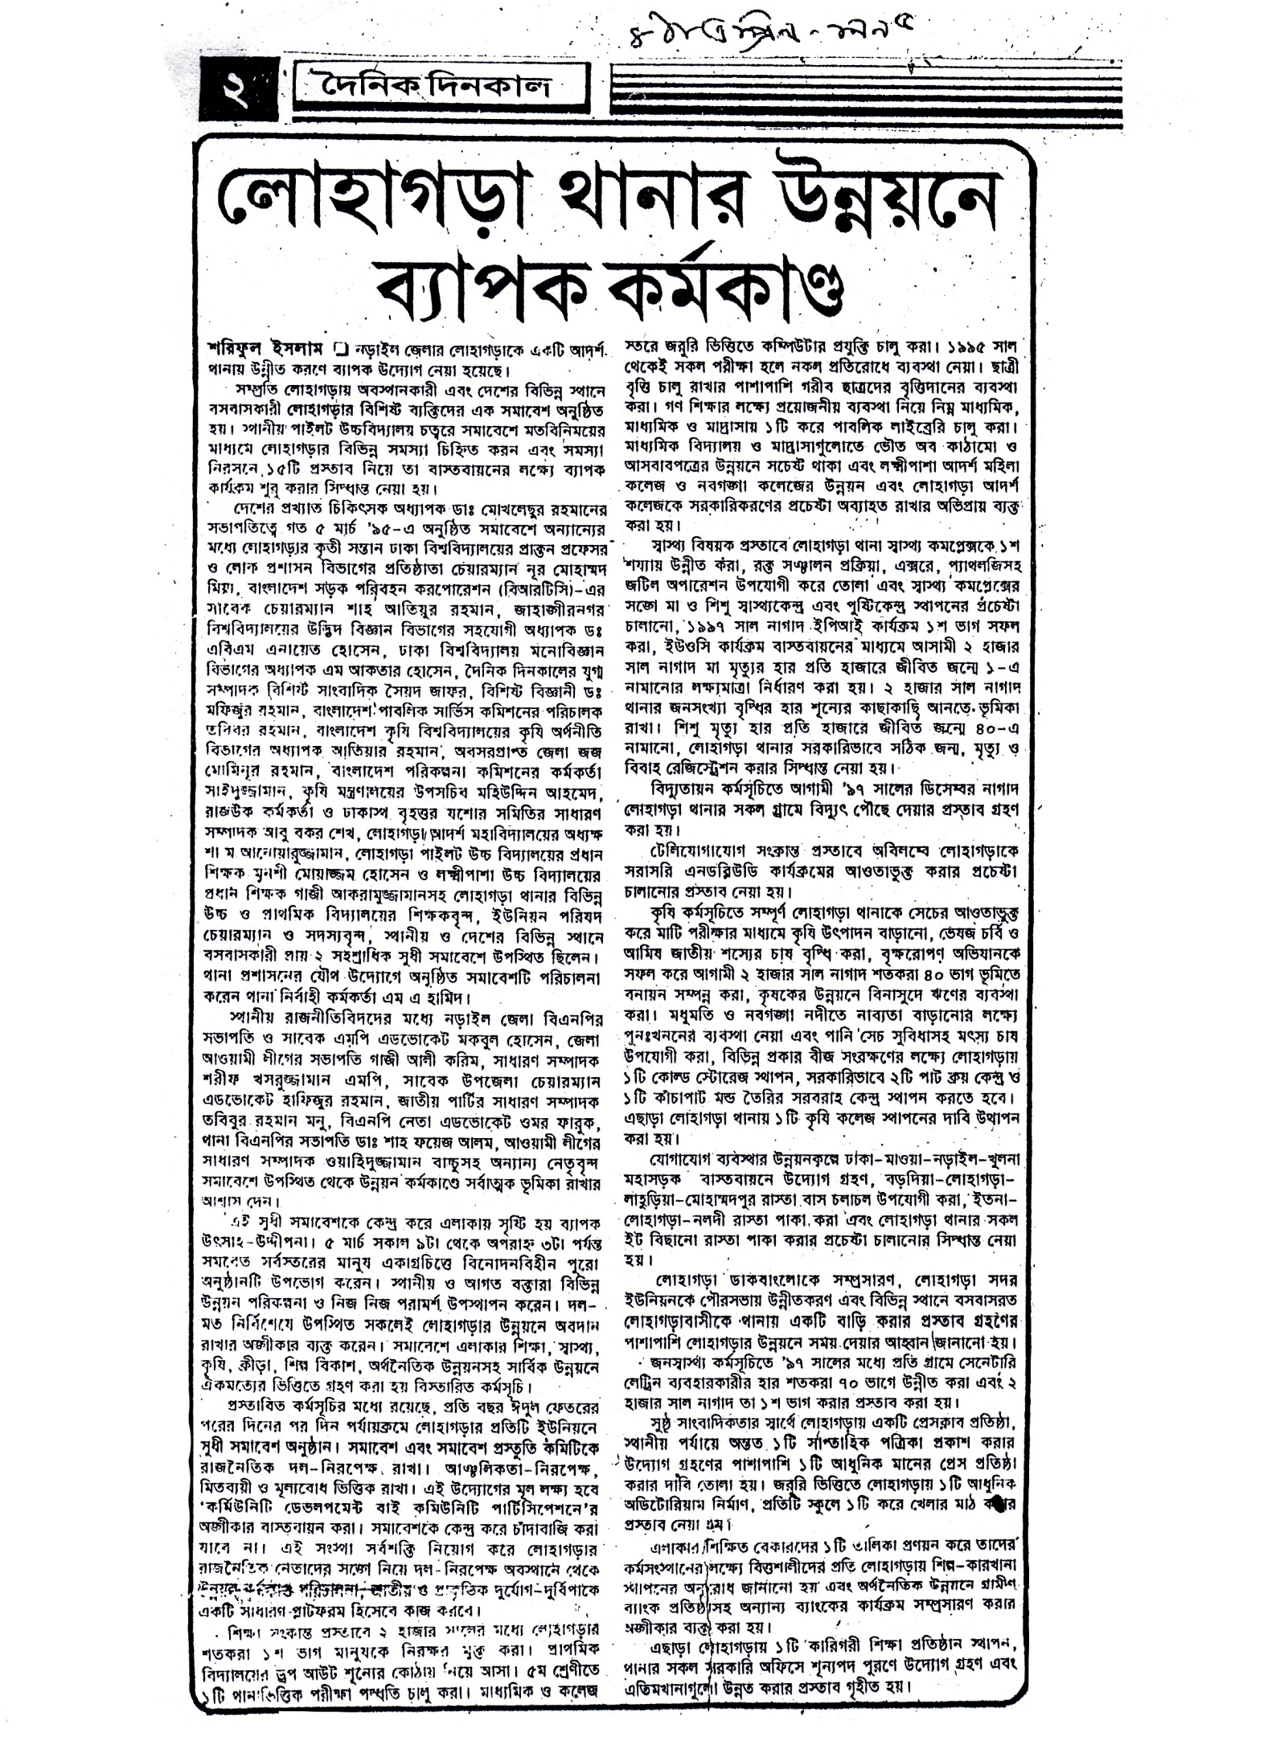

Slide 8


UPAZILA HEALTH COMPLEX
Chowgacha, Jessore.

Slide 9
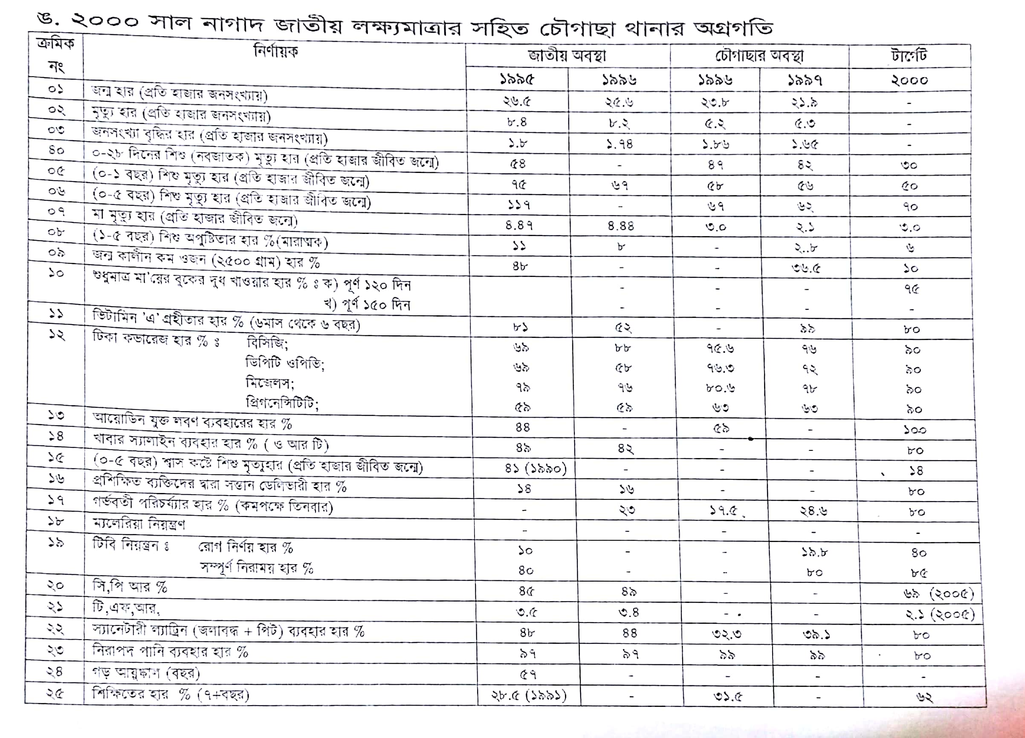

Slide 10

Upazila Health Complex
CHOWGACHA , JESSORE.
EOC Activities : 1997- 2011 (Hospital Delivery )

Slide 11

Upazila Health Complex
CHOWGACHA , JESSORE.
EOC Activities : 2000 - 2011 (Caesarian Section)

Slide 12
Upazila Health Complex
CHOWGACHA , JESSORE.
EOC ACTVITIES : ( Vision By The Year 2010)
SL No | Indicator | Achived |  |  |  |  |  |  |  | Target
 |  | 1997 | 2000 | 2003 | 2005 | 2006 | 2007 | 2008 | 2009 | 2010
01 | ANC 1st Visit % | 24.6 | 59 | 88 | 94.7 | 110.8 | 133.7 | 143.0 | 147 | 100
02 | ANC 2nd Visit % | 11.6 | 33.4 | 59.7 | 68 | 78 | 91.2 | 108 | 119 | 100
03 | ANC 3rd Visit % | 9.2 | 22 | 30 | 39 | 40 | 49.6 | 59.6 | 109 | 100
04 | PNC % | - | 5.5 | 9.9 | 13.5 | 20.11 | 11.2 | 39.3 | 64 | 80
60 | Hospital Delivery Rate% | 3.4 | 6.4 | 15 | 26.5 | 32.3 | 38.1 | 52.4 | 72 | 90
06 | Caesarian Section Rate% | 0 | 0.07 | 0.8 | 6.3 | 7.4 | 9.6 | 11.0 | 17.3 | 15
07 | Maternal Mortality Ratio / 100000 Live birth | 210 | 168 | 114 | 160 | 150 | 160 | 120 | 42 | 42
08 | Neonatal Death Rate / 1000 live birth | 42.4 | - | 28 | 21.5 | 20.5 | 21.5 | 16.5 | 19.3 | 15

Slide 13
MDG 4 and 5 Achieved at Chowgacha in 2009
Per 1000 live Birth Chowgacha MDG Target National
MMR: .42 1.47 3.2
(MDG 5 Achieved)
IMR: 20.6 31 52
(MDG 4 Achieved)
<5 MR: 22.7 50 65
(MDG 4 Achieved)

Slide 14
Upazila Health Complex
CHOWGACHA , JESSORE.
Comparative Data of Delivery of best performing EOC center of Khulna Division in 2011
SL No | Name of institute | NVD | Vacuum Del. | V. Breech | C. Section | Total
01. | Chowgacha UHC | 3346 | 34 | 26 | 1007 | 4413
02. | Ad-din Hospital Jessore. | 1124 | 0 | 0 | 1864 | 3492
03. | Khulna Medical College Hospital | 1581 | 58 | 18 | 1356 | 3013
04. | 250 bed Hospital, Jessore | 1327 | 2 | 25 | 1498 | 2852

Slide 15
Chowgacha Health Complex – improvement evaluation (1995-2017)
Subject | 1995 | 1996 | 1997 | 2000 | 2003 | 2007 | 2011 | 2017
Bed Occupancy Rate % | - | - | 78.9 | 93.5 | 88.9 | 201 | 208 | 171
ANC (First Visit) | - | 16.3 (817) | 24.6 (1228) | 59 (2861) | 88 (4484) | 132 (7292) | 170 (8935) | 130 (6632)
Hospital Delivery Rate % | - | 2.1 (99) | 3.4 (151) | 6.4 (422) | 15 (661) | 38.1 (1899) | 98.4 (4413) | 66 (2932)
C-Section rate % | - | .02 (1) | 0 | 0.07 (3) | 0.8 (36) | 9.6 (473) | 22.5 (1107) | 17
Population Increase rate | 1.87 | 1.86 | 1.66 | 1.7 | 1.57 | - | 1.36 | 1.71
Maternal Mortality Ratio/100,000 live birth | 599 | 300 | 206 | 168 | 114 | 160 | 68 | 91
Neonatal mortaliy rate/ 1000 live birth | 42 | 47 | 42.4 | 23 | 28 | 21.5 | 18.2 | 16.6
Infant mortaliy rate/ 1000 live birth | 65 | 58 | 56 | 36 | 34 | 29.2 | 23.6 | 18.6
Under 5 mortaliy rate/ 1000 live birth | 78 | 67 | 62 | 44 | 43 | 33.3 | 25.7 | 21.1
Low birth weight rate(%) | - | - | 36.5 (74) | 15.2 (288) | 13.7 (636) | - | - | -

Slide 16


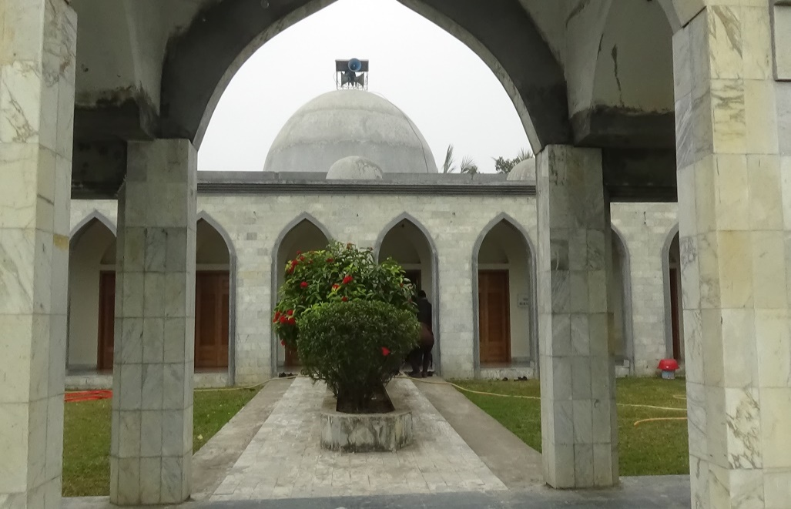
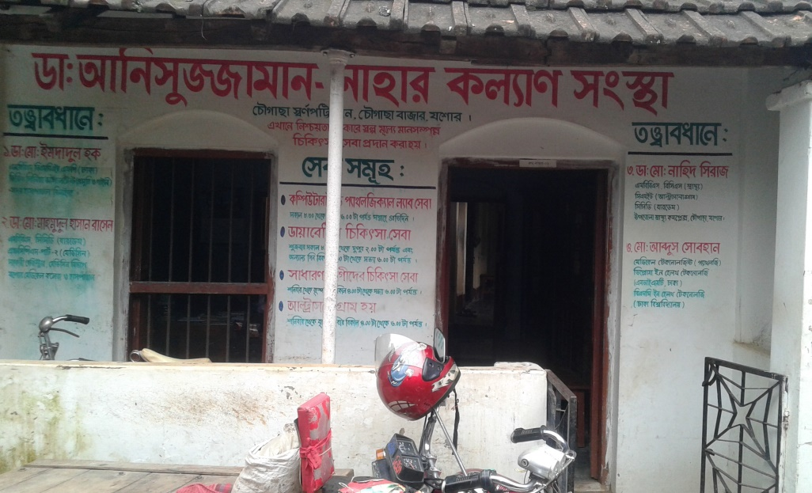
Development of Chowgacha Upazilla by Divine Group

Slide 17
Development of Chowgacha Upazilla by Divine Group

Slide 18

100 kh¨v wewkó m`i nvmcvZvj, wSbvB`n

Slide 19
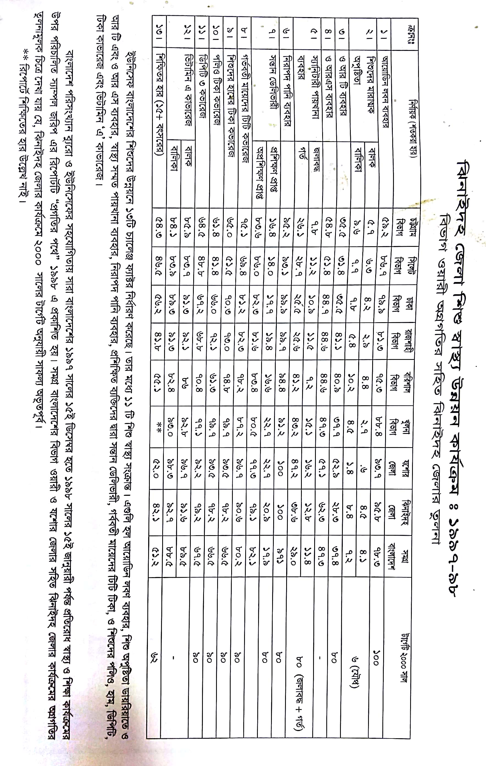

Slide 20
Challenges of the hospital in 2012
In secured hospital environment.
Performance of all activities was very low.
Very limited support staff.
Receiving money from the patients by non-govt. staff.
Waste management system was poor.
Monitoring meeting was not performed regularly

Slide 21
Health ,Nutrition and population targets for the 7th FYP
Sr # | Indicator (Impact/Outcome) | Base year’s information(source with year) | 7th FYP target FY 2020
1 | Life Expectancy at Birth | 70.4 (SVRS 2013) | 72
2 | Under-five Mortality Rate (per 1,000 live births) | 46 (BDHS 2014) | 37
3 | Infant Mortality Rate (per ,1000 live births) | 38 (BDHS 2014) | 20
4 | Maternal Mortality Ratio(per 100,000 live births) | 170 (MMEIG 2013) | 105
5 | Proportion of Under Weight among Under-five children (%) | 32.6 (BDHS 2014) | 20
6 | Proportion of stunting among Under-five children (%) | 36.1 (BDHS 2014) | 25

Slide 22
Health ,Nutrition and population targets for the 7th FYP
Sr # | Indicator (Impact/Outcome) | Base year’s information(source with year) | 7th FYP target FY 2020
8 | Total Fertility Rate (Children per Woman) | 2.3 (BDHS 2014) | 2.0
9 | Contraceptive Prevalence Rate (%) | 62.4 (BDHS 2014) | 75
10 | Proportion of children fully vaccinated by 12 months (%) | 78 (BDHS 2014) | 95
11 | Proportion of births attended medically trained provider (%) | 42.1 (BDHS 2014) | 65
12 | Proportion of births in health facilities by wealth quintiles (Ratio of lowest and highest quantities) | 15:69.5 (BDHS 2014) | 1:3.5
12 | TB case detection rate (%) | 53 (GTR 2014 ) | 75
Source: Ministry of Health and Family Welfare

Slide 23
Emergency & Out Door, Indoor Service 1998 to 2017
Sadar Hospital, Jhenaidah

Slide 24

Sadar Hospital, Jhenaidah
Bed Occupancy Rate from 1998 to 2017

Slide 25
3 best performing EmOC Hospital in Khulna division - 2017
Sadar Hospital, Jhenaidah

Slide 26
Achievements of Jhenaidah Sadar Hospital
1. Active Community Participation is an example in Bangladesh.
2. Improved performance of all services.
3. Improved Cleanliness and Beautification of Campus.
4. Functioning of X-Ray service and Biochemistry investigation
5. Improved Security
6. Improved Financial Management
7. “Model ” is replicating in 11 district and 5 upazilla hospital
8. The hospital is awarded 7 times from 2013 to 2018.

Slide 27




Hospital Environment

Slide 28

Thank you
Notes:
28

